Slide 1
Fantastic 4: Our Team
Our team, Fantastic 4, is dedicated to developing a reliable and innovative gas detection system. We have combined our expertise in electronics, software, and chemistry to create a solution that can effectively identify and measure different gases.
Swam Singla
Shubham Goel
Inesh Dheer
Shreyas Mehta

Slide 4
Co
H2S
NH3
CH4
Smoke
LPG

Slide 5

Week 3-4 Report:
Inesh | Shreyas | Shubham | Swam
Wrote the main working code for the ESP32/MQ-7 sensor along with DHT 11 integration and circuitry work. Made and setup the Thing Speak channel which in turn made the graphical analysis possible, helped Shreyas in calibration. Did raw data collection and made this presentation. | Mathematical Relations for: Rs/Ro vs ppm for MQ2 (CO and Methane) Derived equations for humidity and temperature for general MQ series. Why is MQ7 better ? Shifted from MQ2 to MQ7 and derived relations and calibrated MQ7. Implemented with the help of fitting model (non linear regression). | GUI Real time graphs Emergency button for buzzer alert Capture graph data Performed experiments for data collection. | Gave a different approach for humidity and temperature (Lookup table method) curves for linear relations (assumptions valid for MQ2) and derived the same, did the proximity check and helped in experimental analysis. Verified Shreyas’ formula.

Slide 6
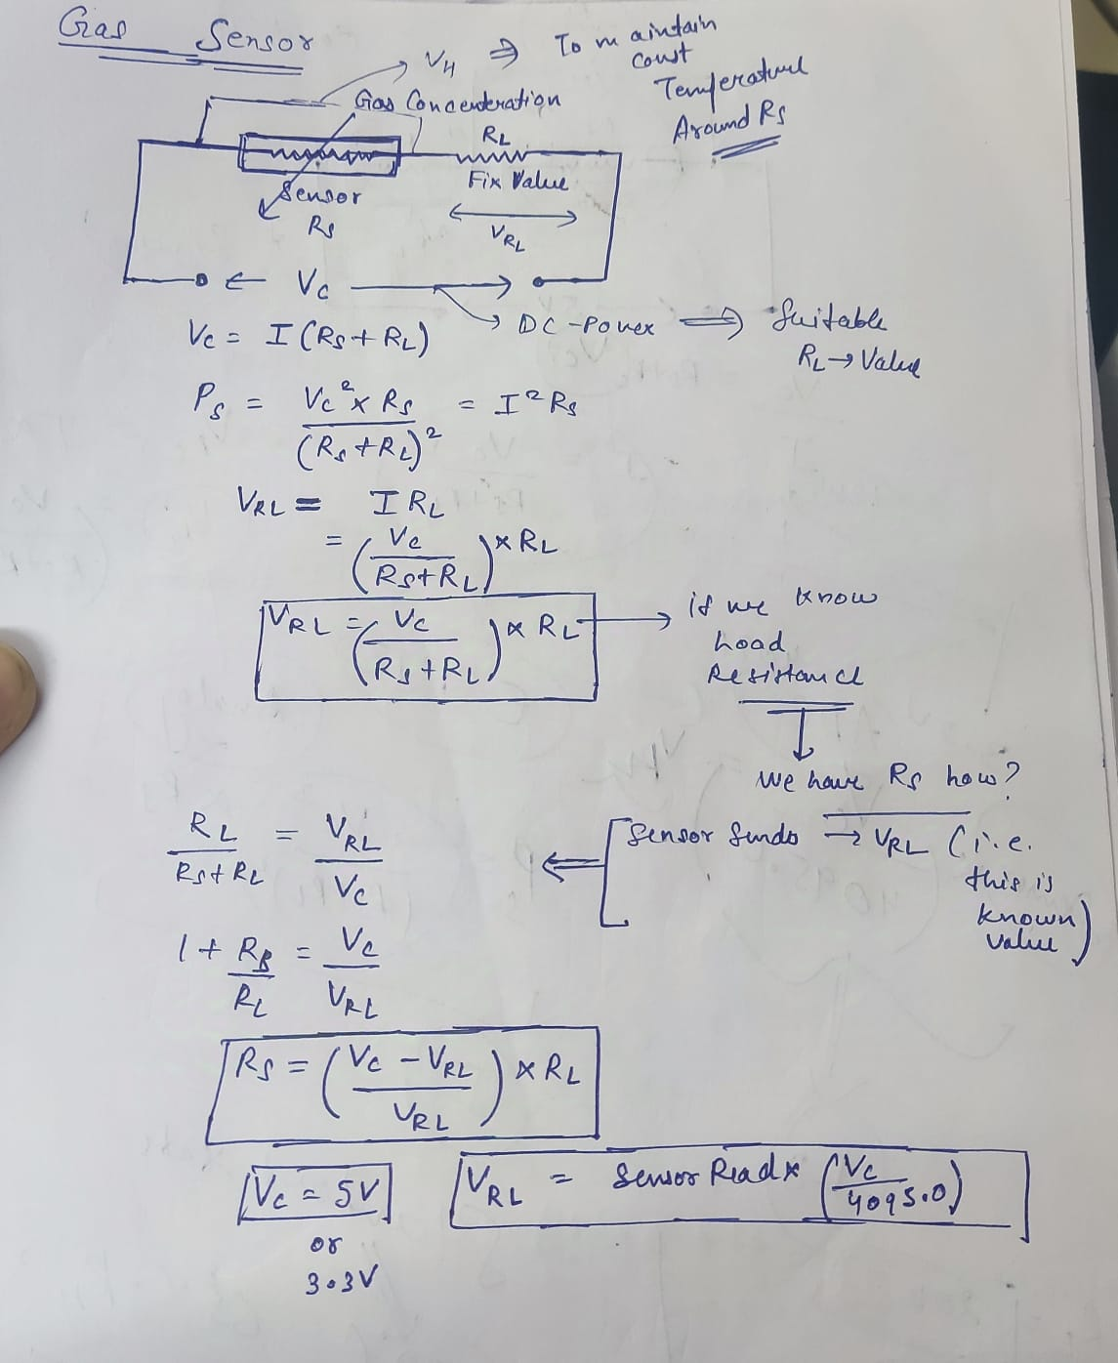
Circuit Design of our sensor:

Slide 7
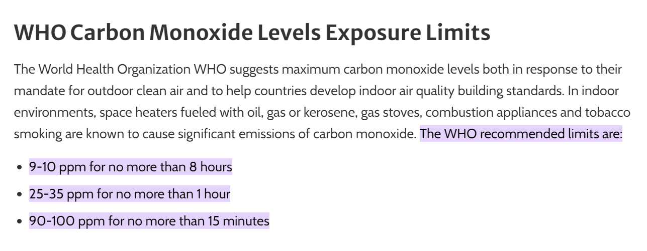
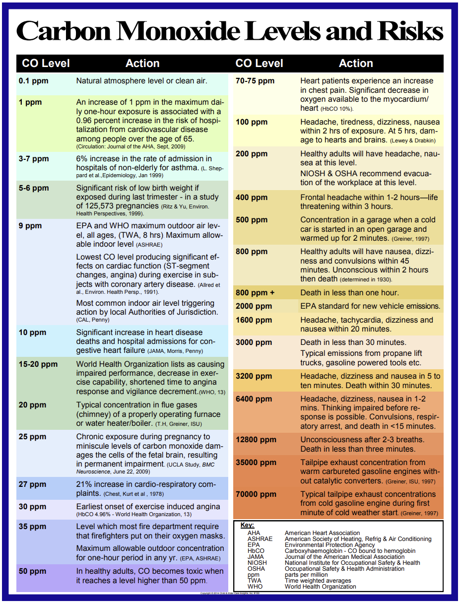
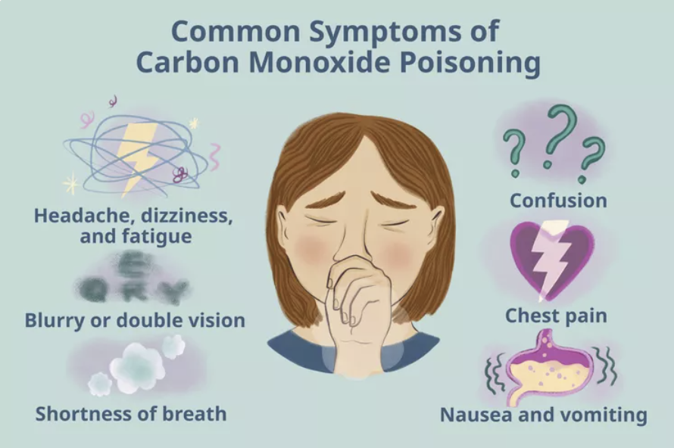

Slide 8
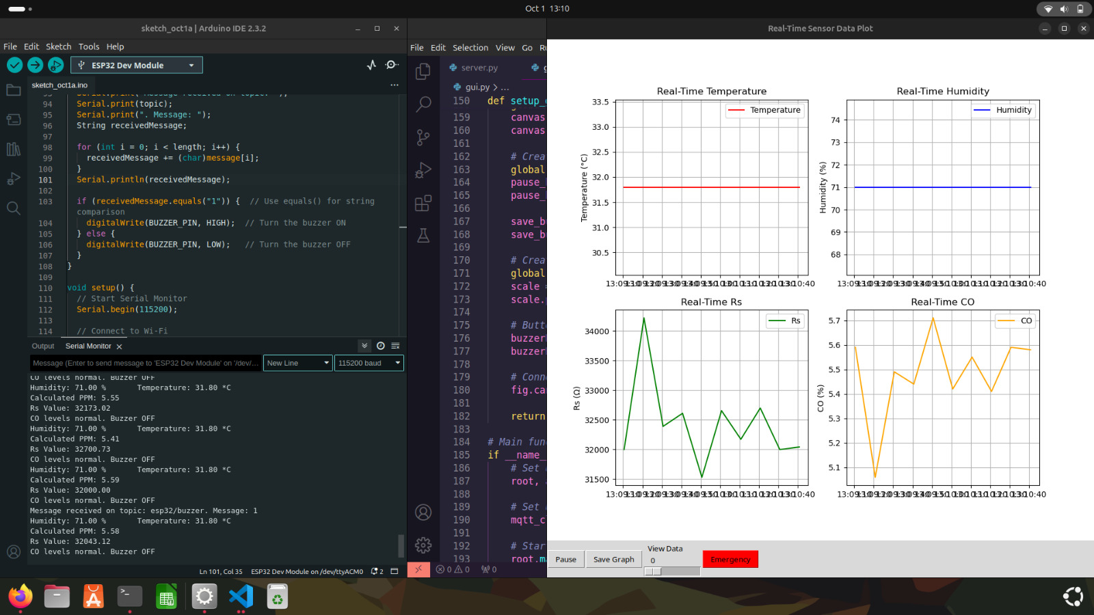
GUI

Slide 9
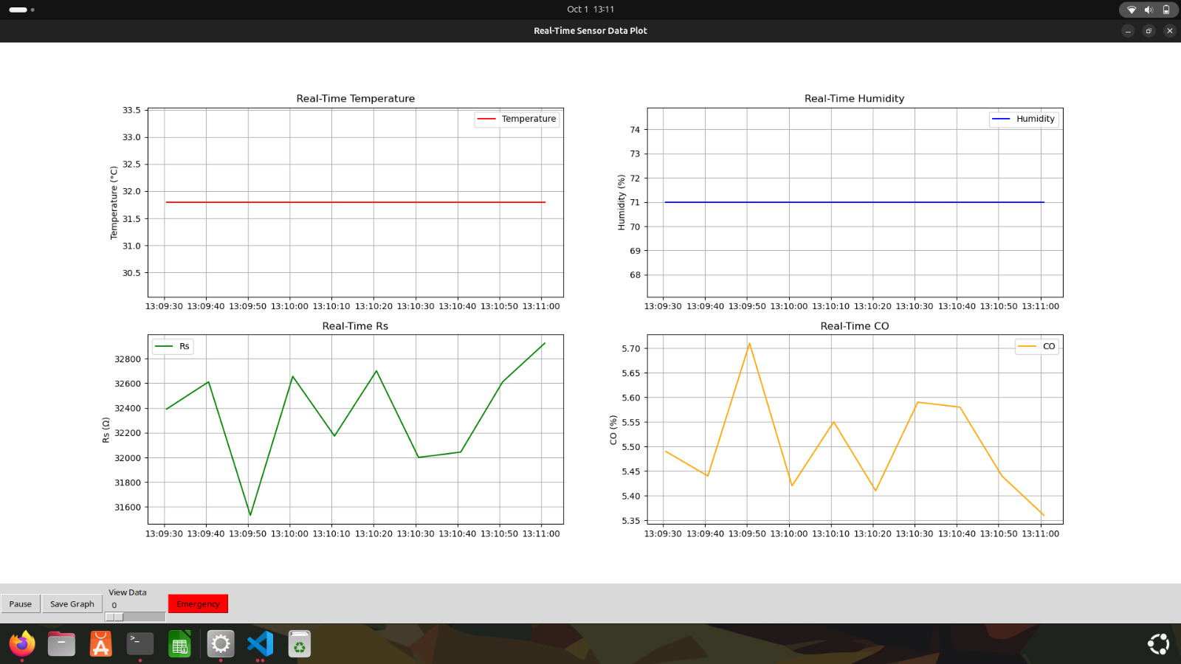

Slide 10
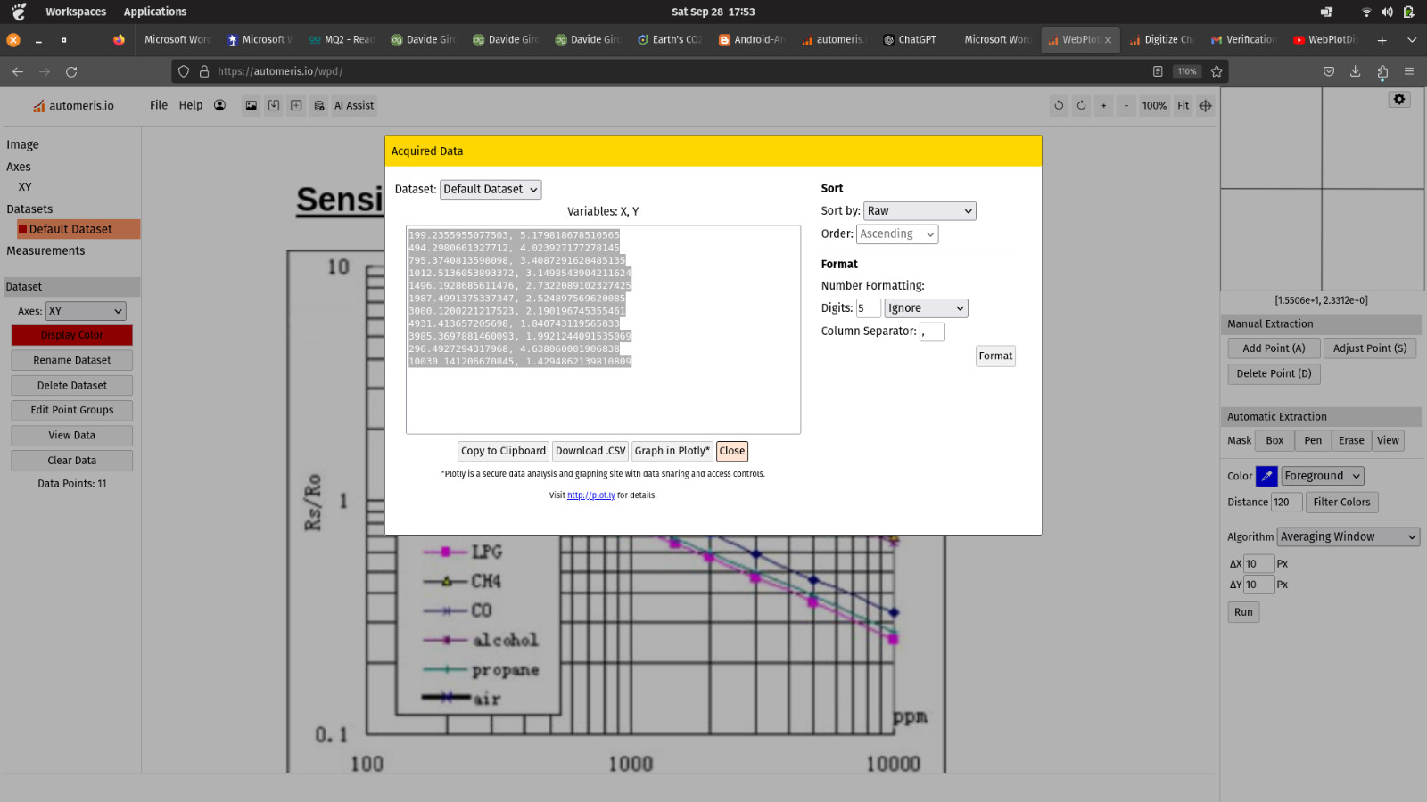
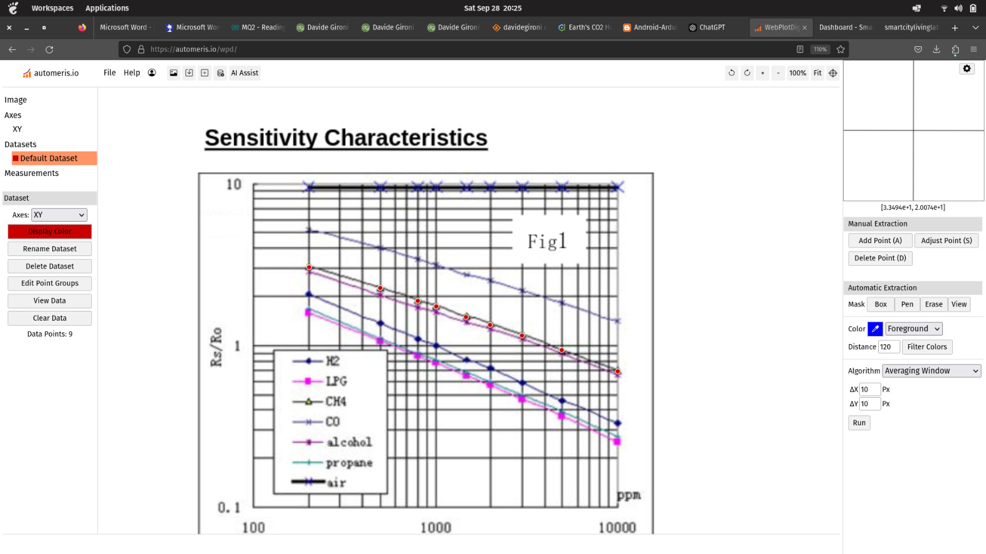
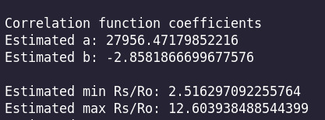
ppm = a*(Rs/Ro)^b
Site: (This implementation was done only for MQ 135) https://davidegironi.blogspot.com/2014/01/cheap-co2-meter-using-mq135-sensor-with.html
Note:
Graph taken from MQ2’s datasheet

Slide 11
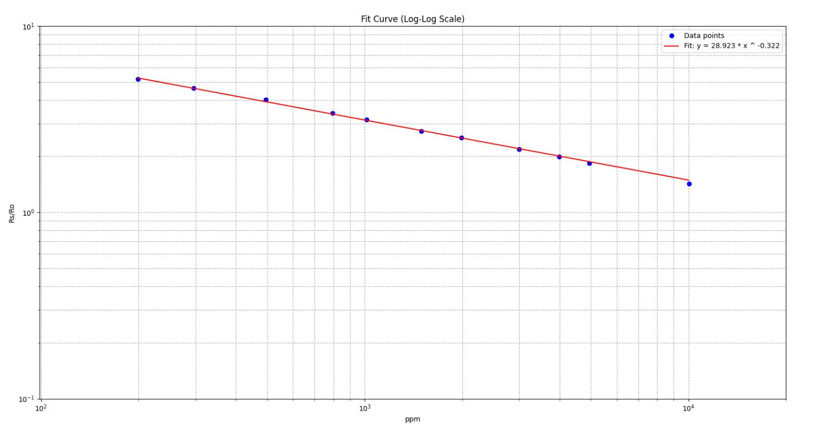
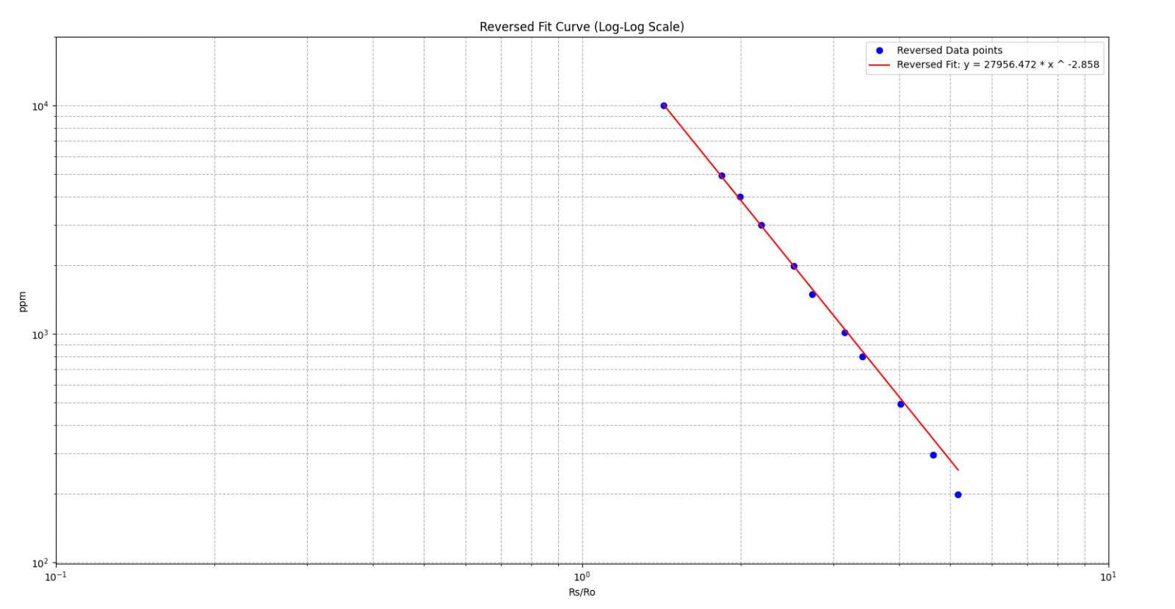
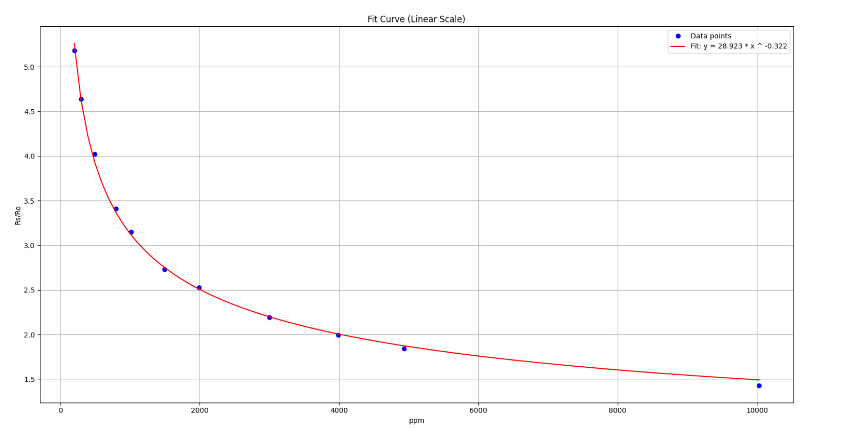
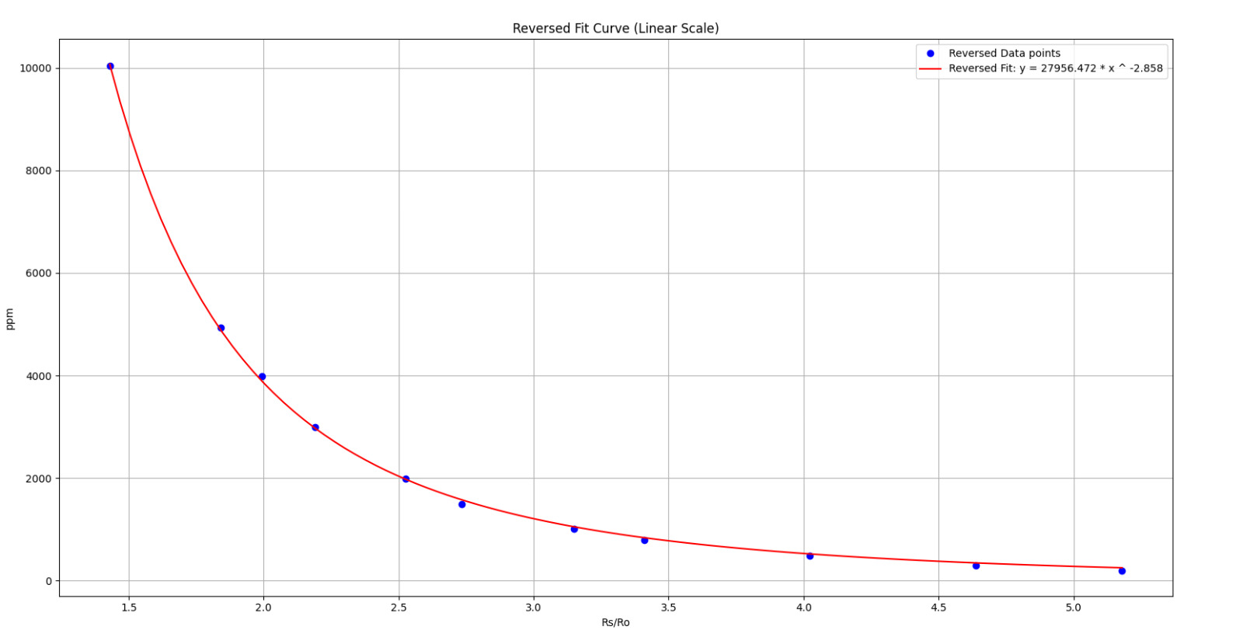

Slide 12
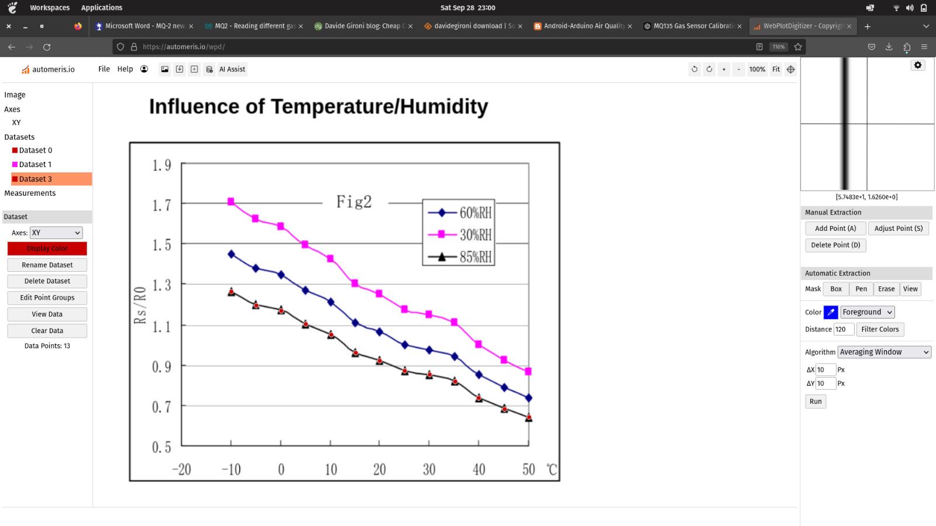
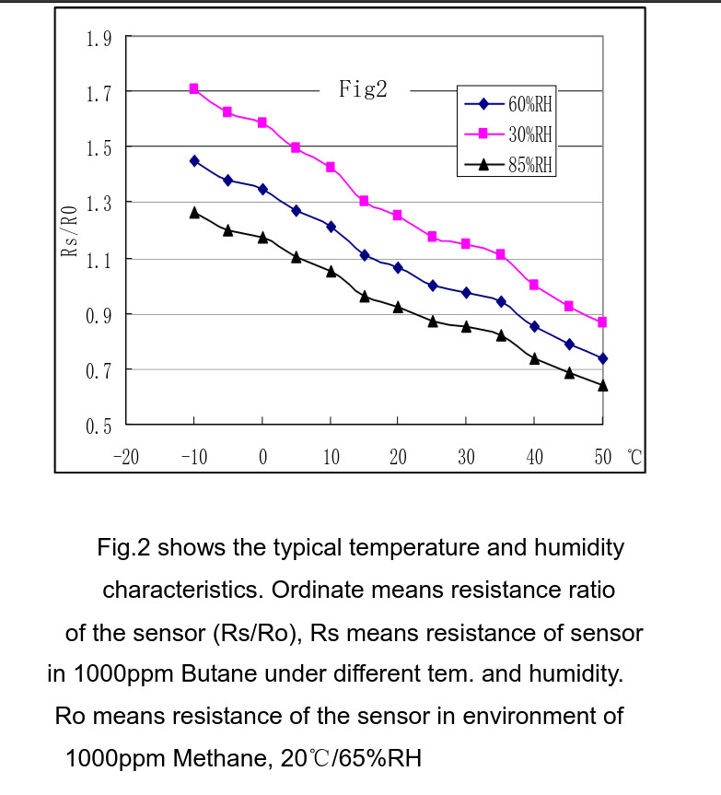
Deriving relations for humidity and temperature for MQ2 sensor

Slide 13
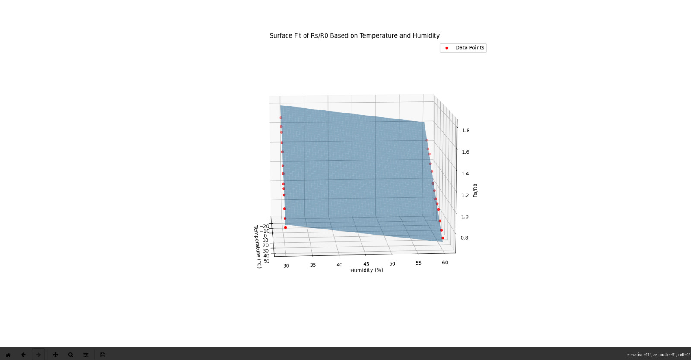
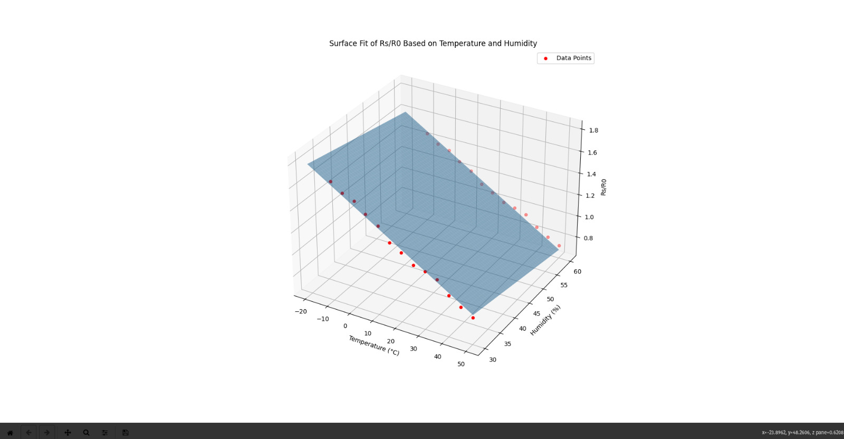
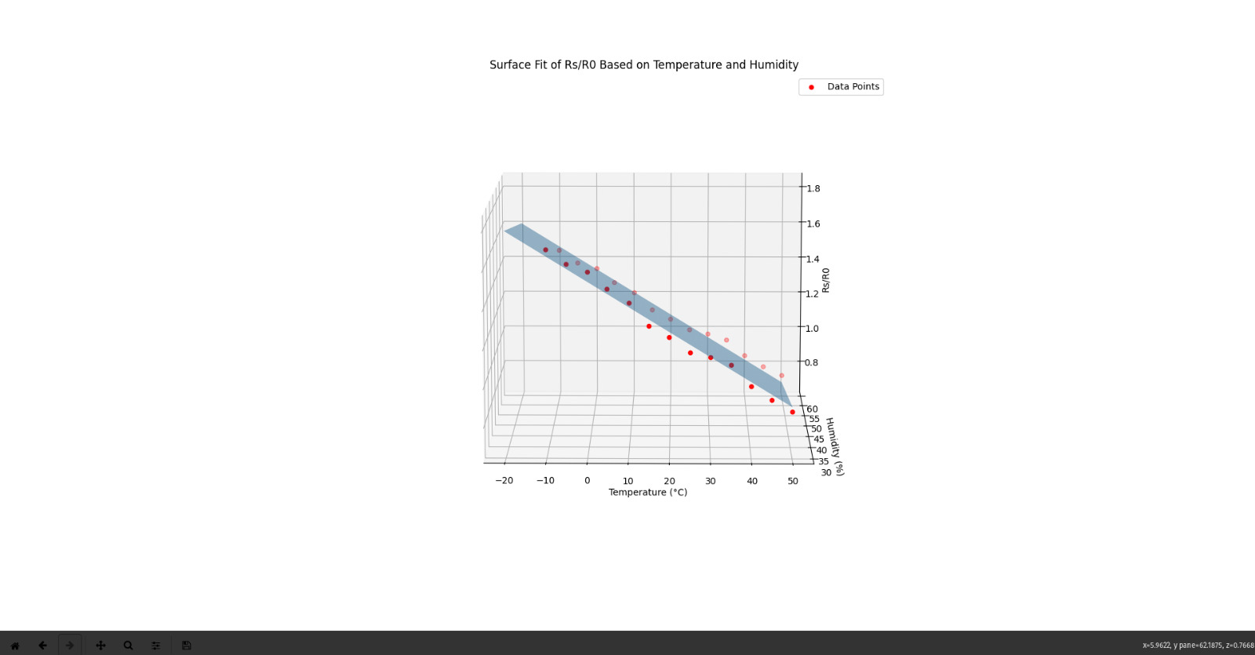
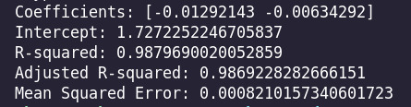

Slide 14
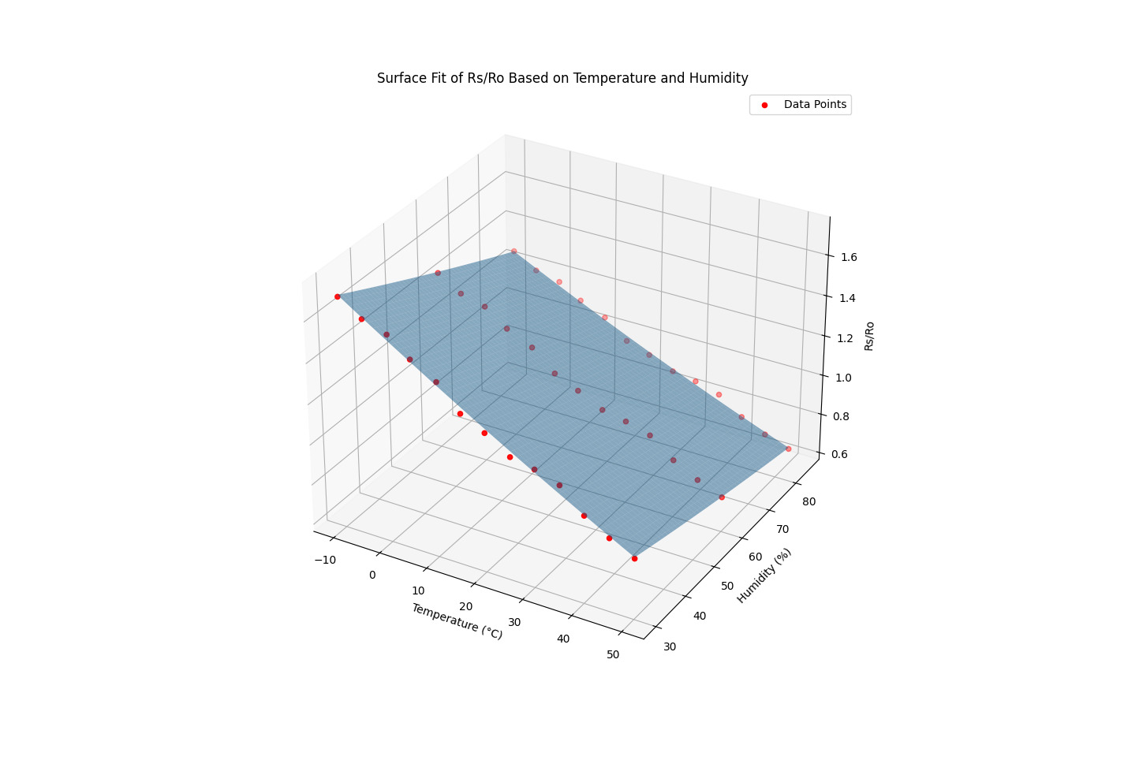
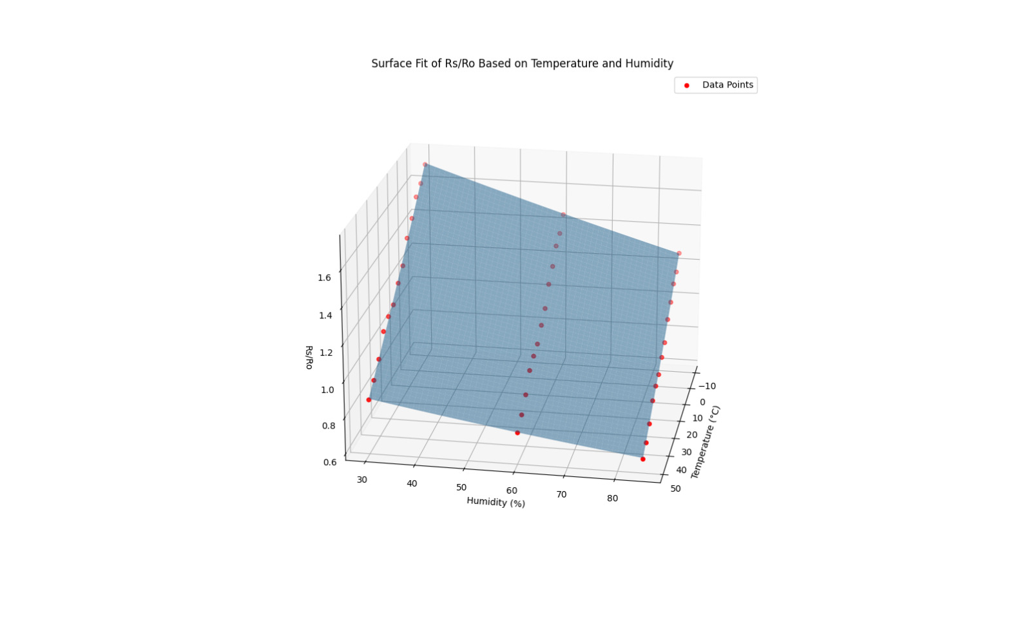
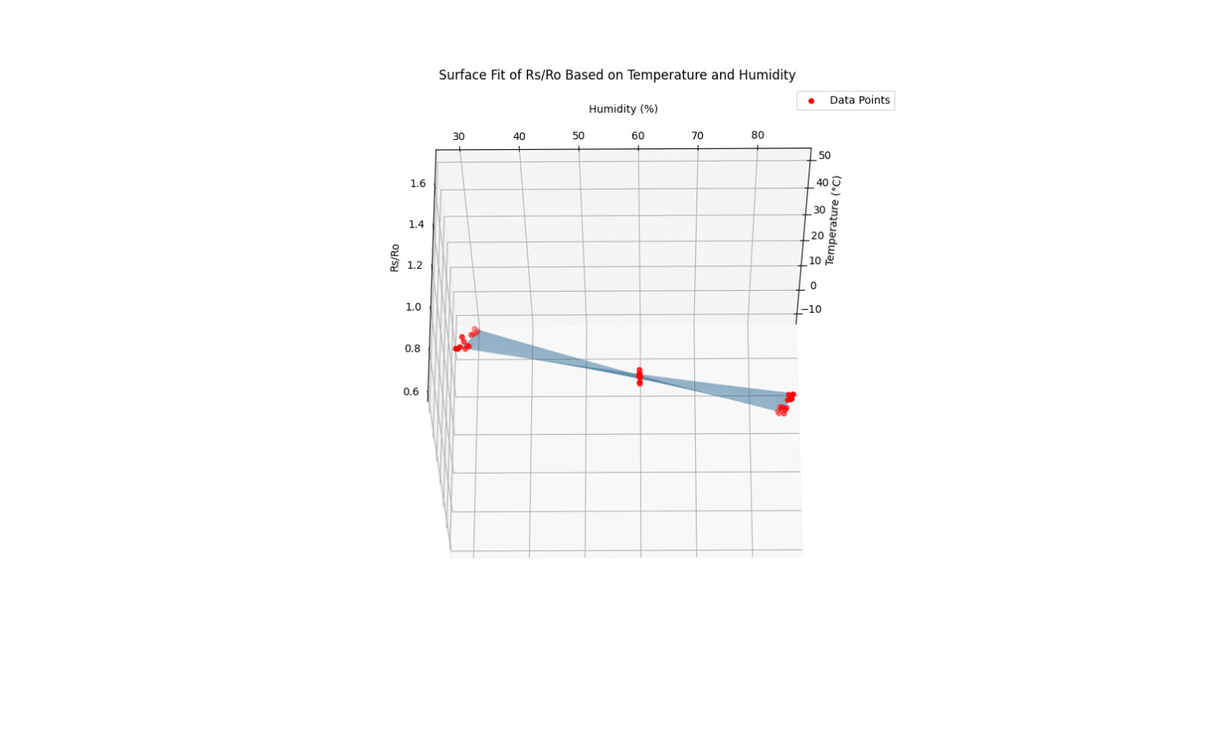
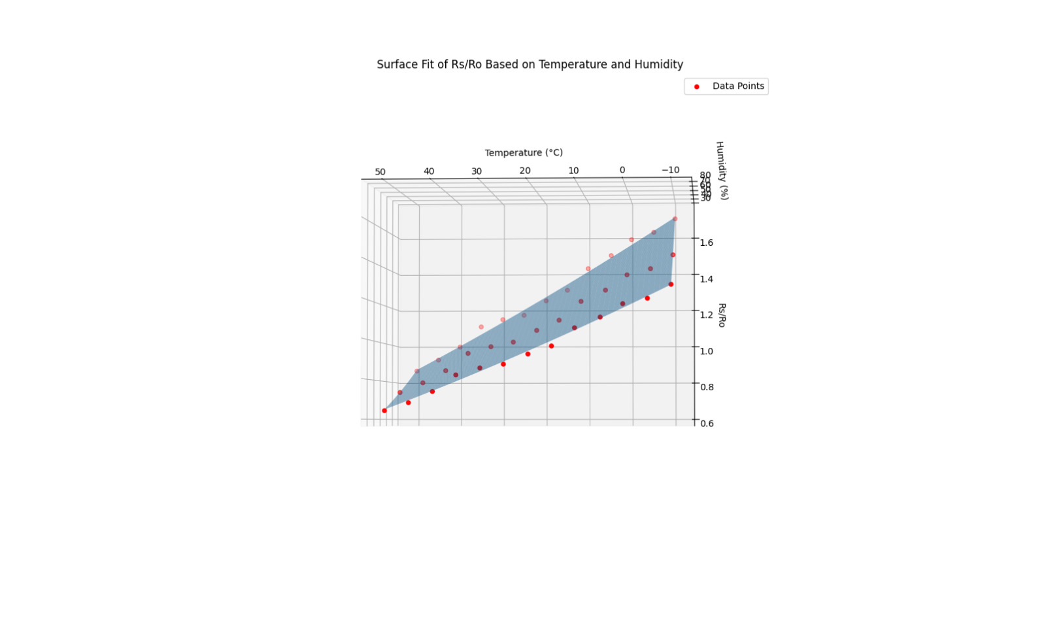

Slide 15
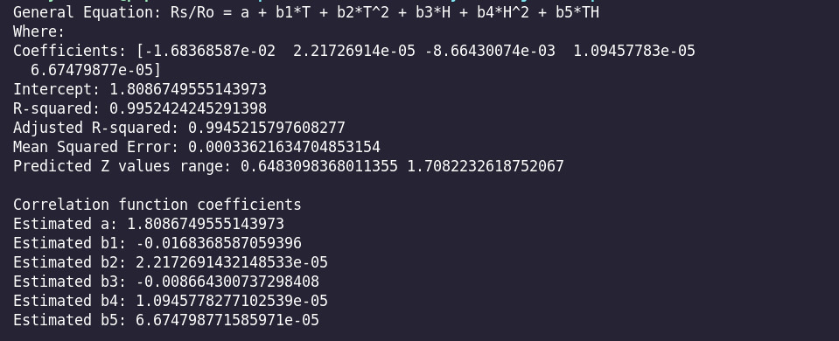
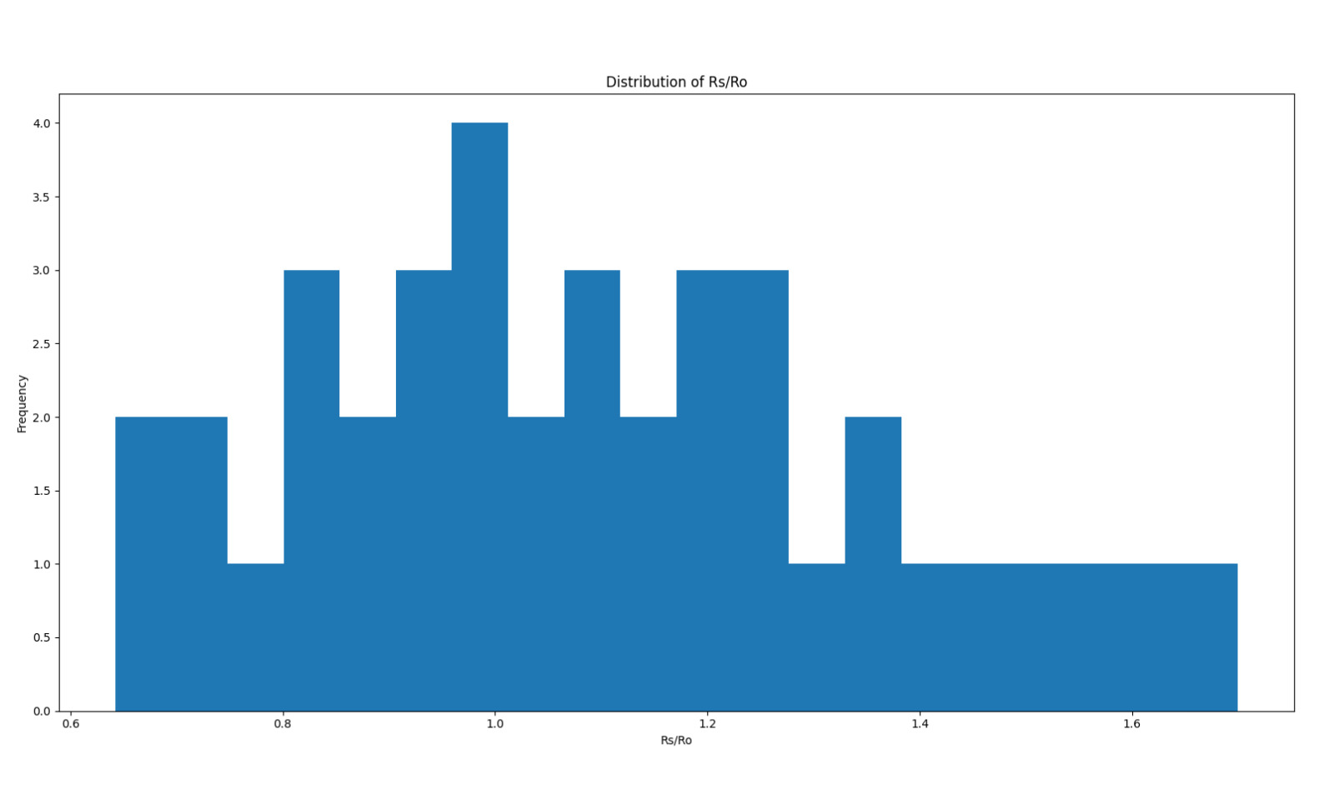
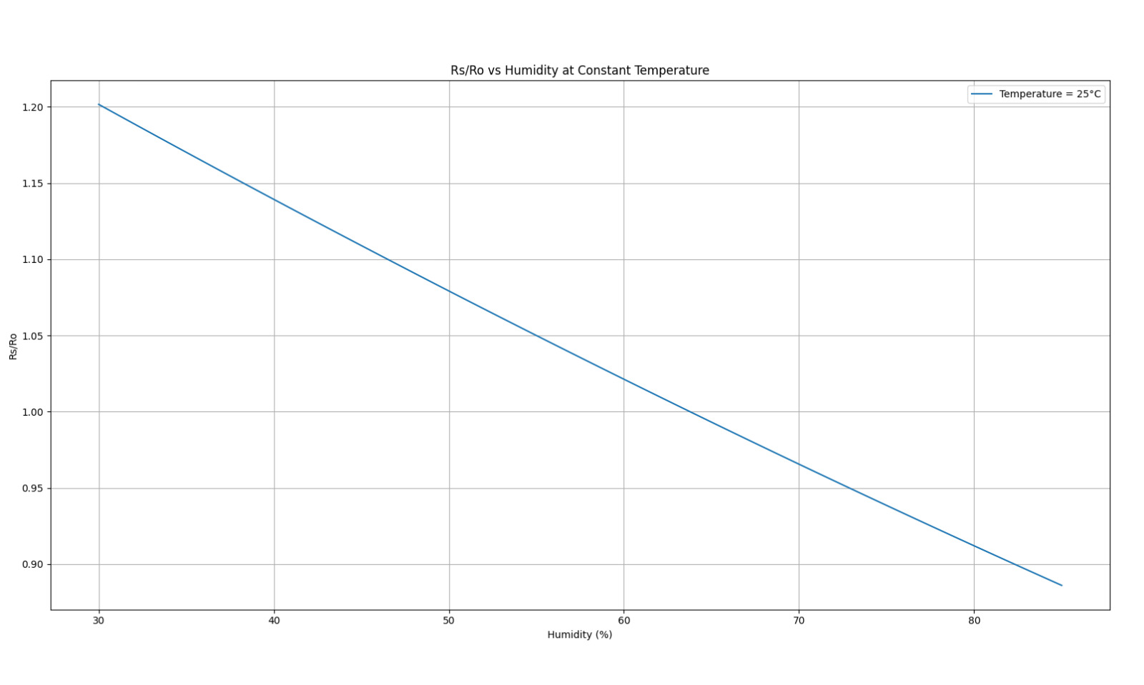
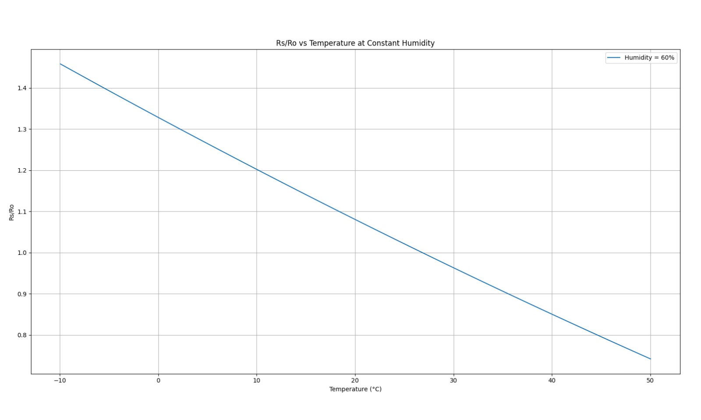

Slide 16
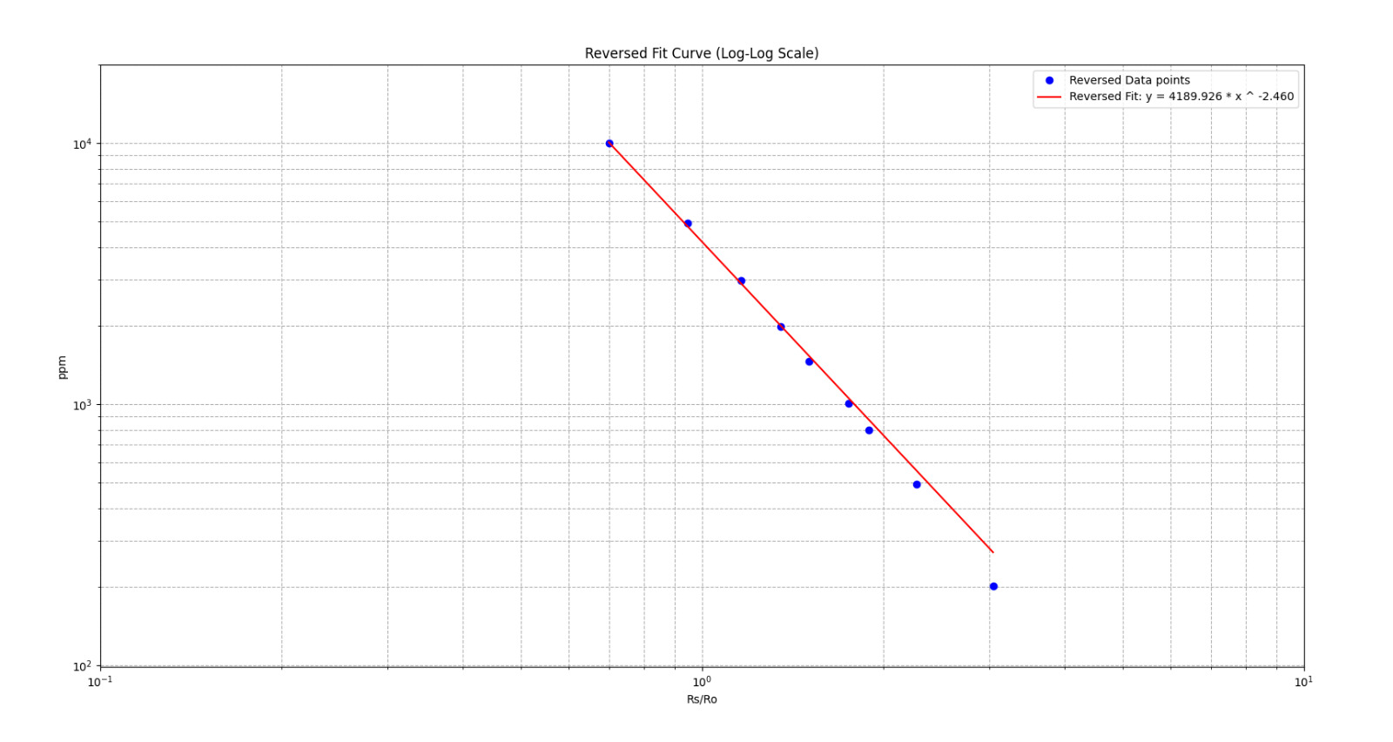
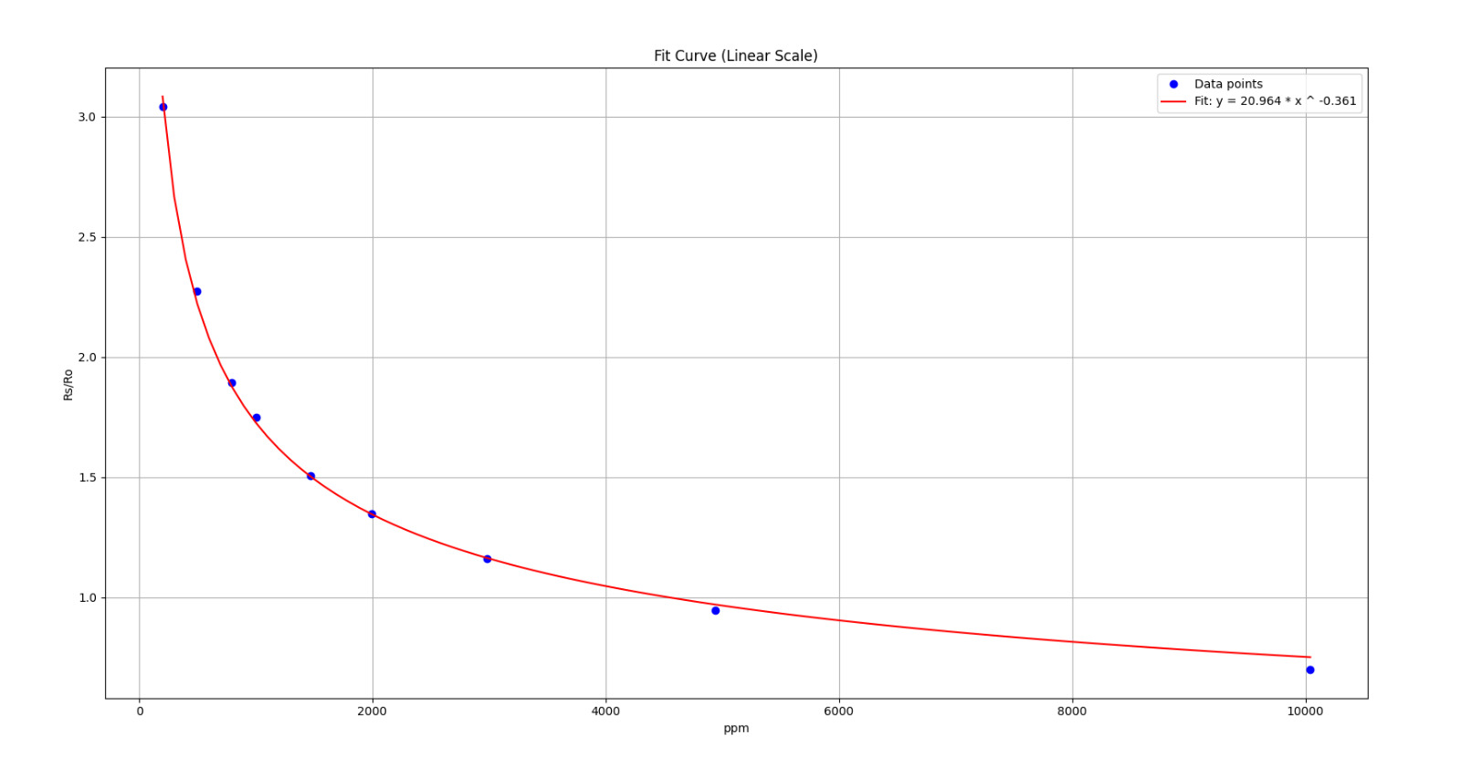
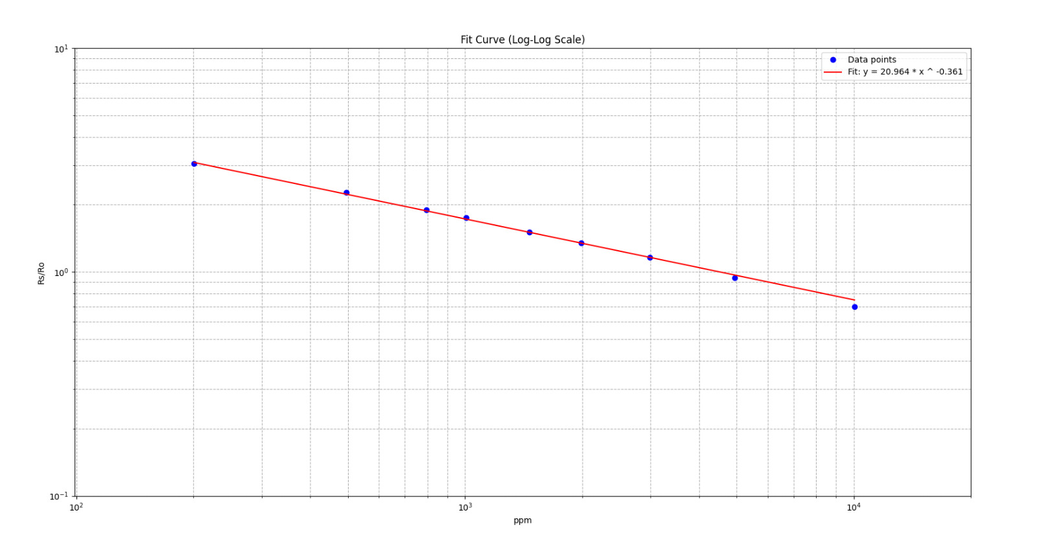
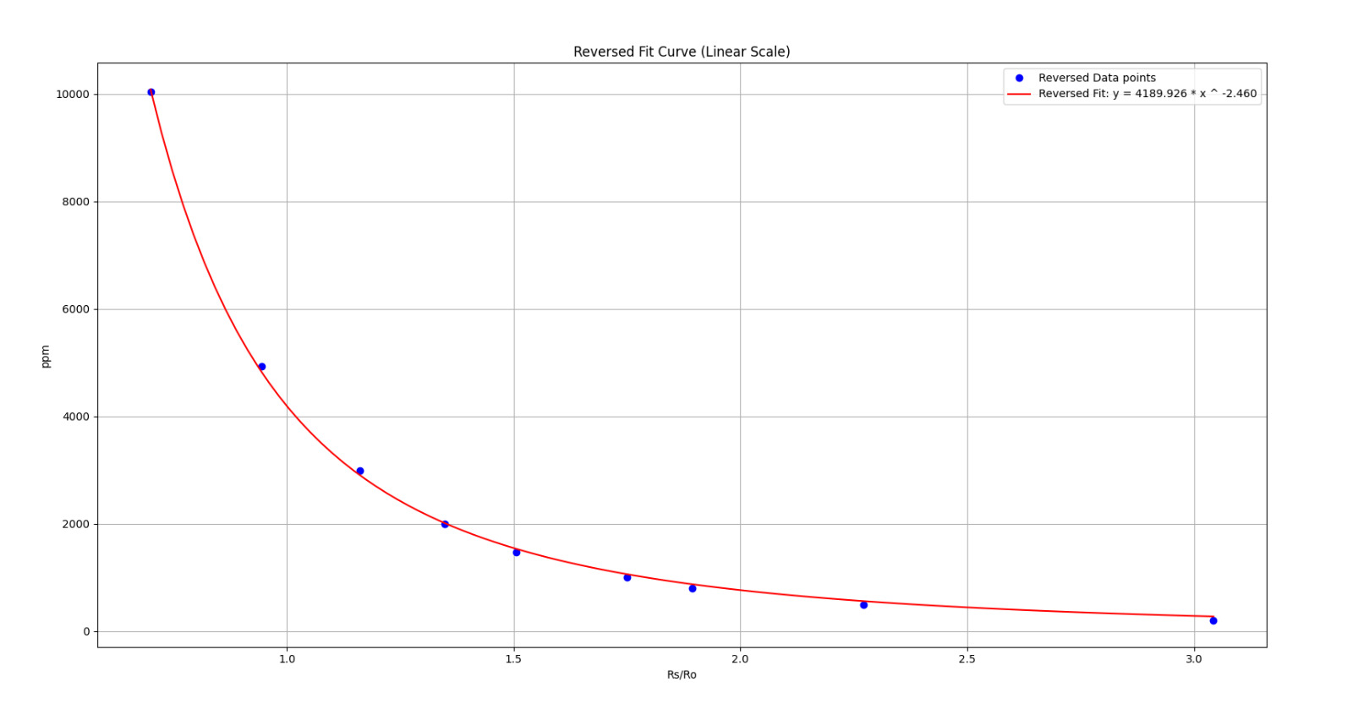
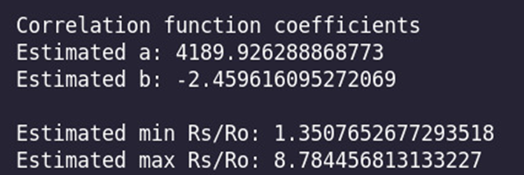
Now for Methane

Slide 17
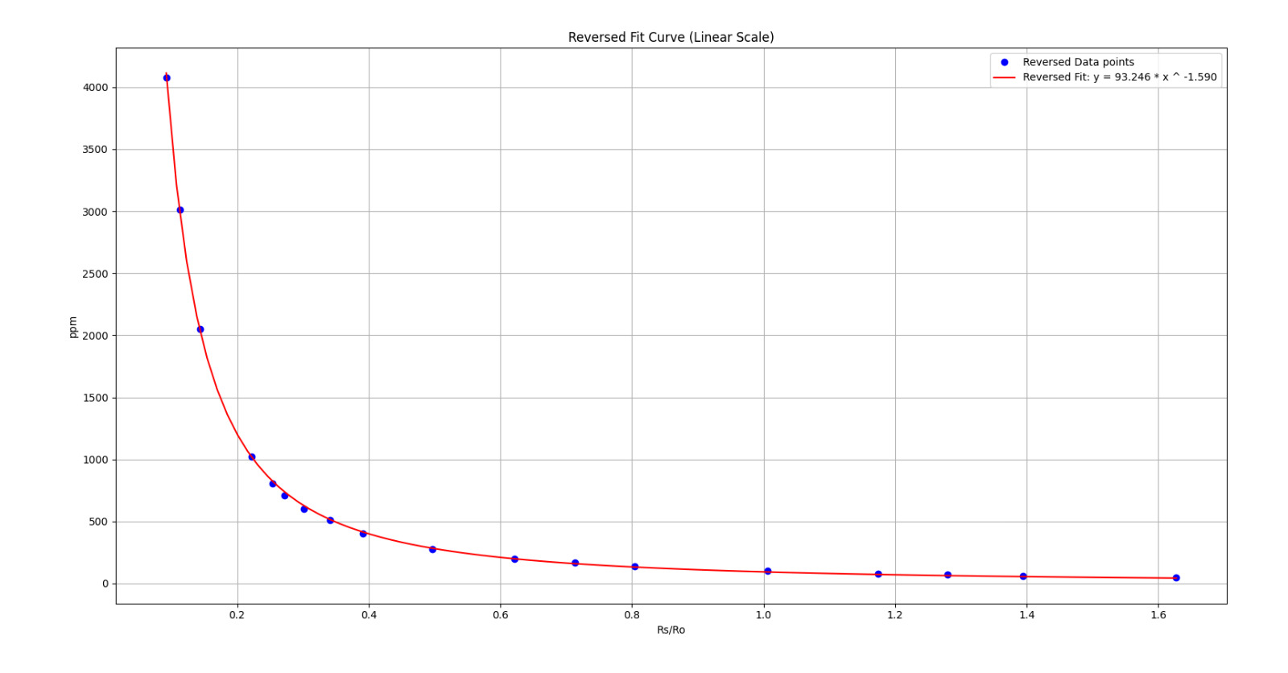
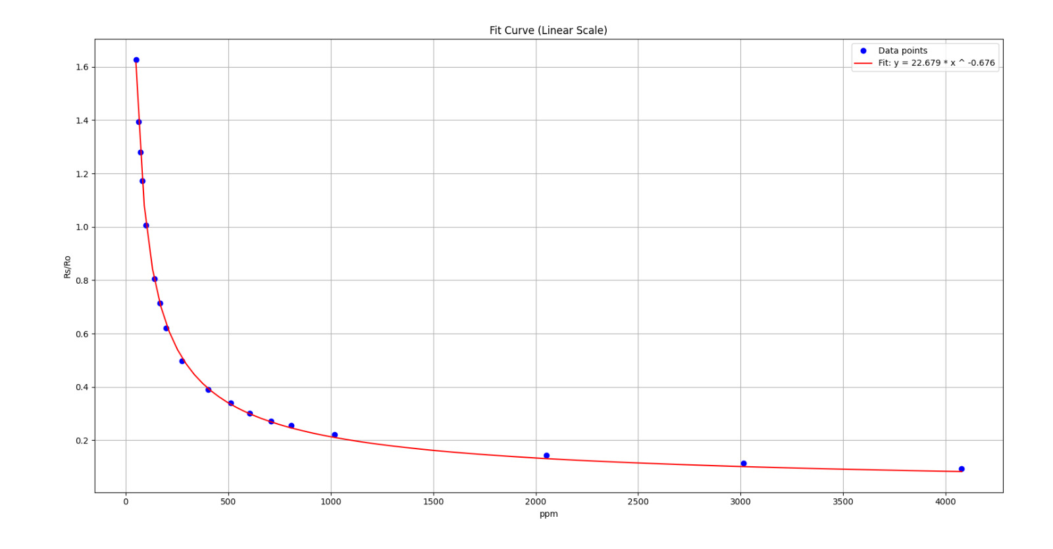
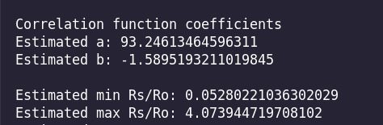
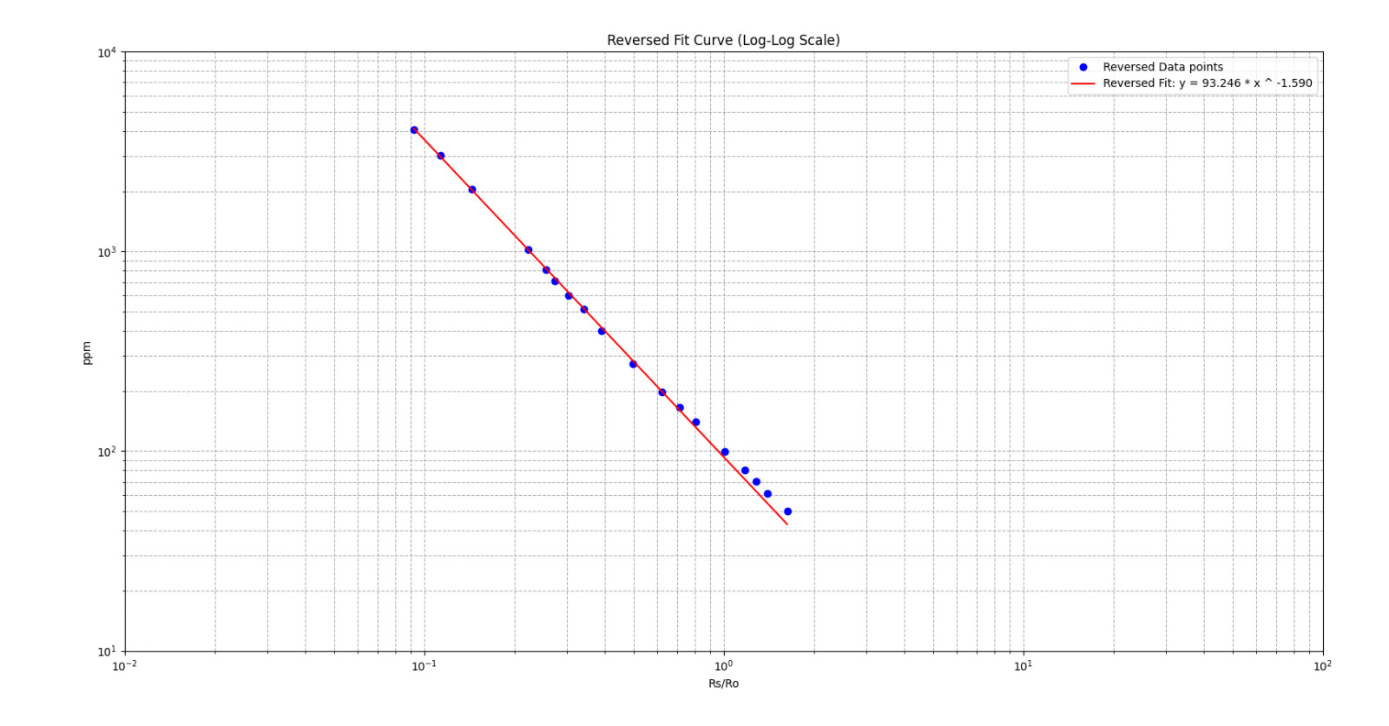
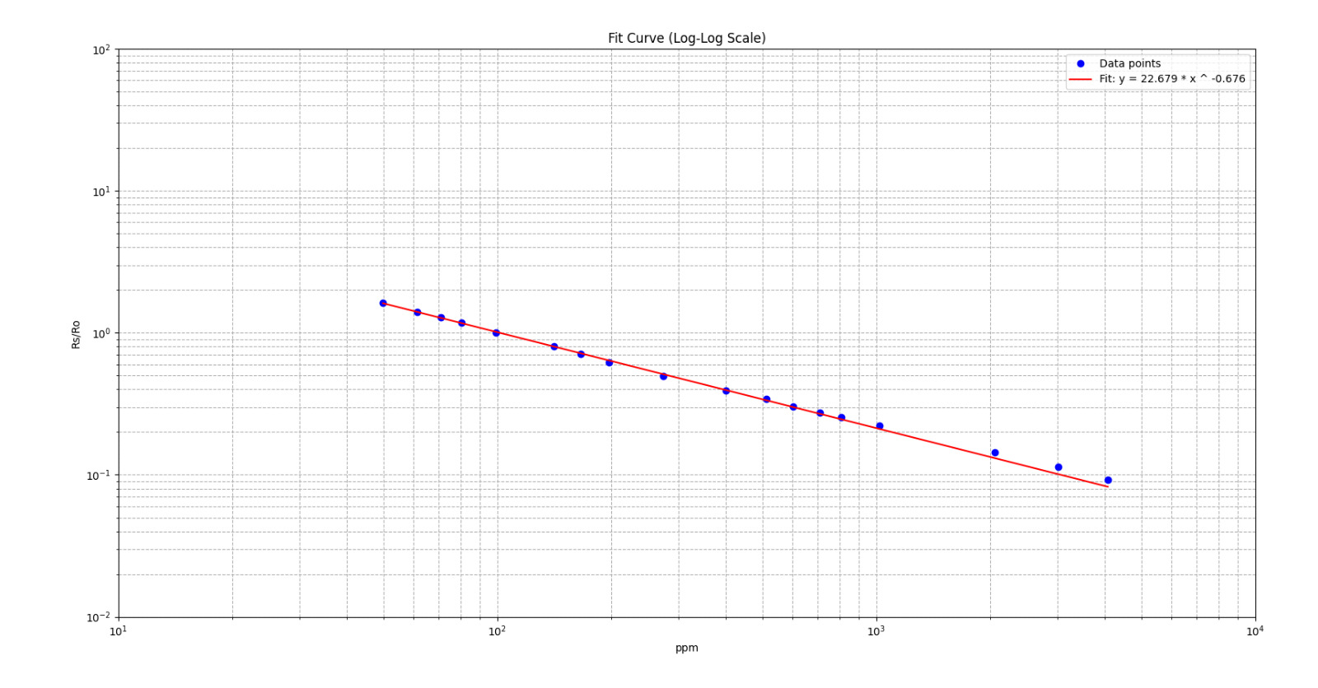
MQ 7 Carbon Monoxide

Slide 18
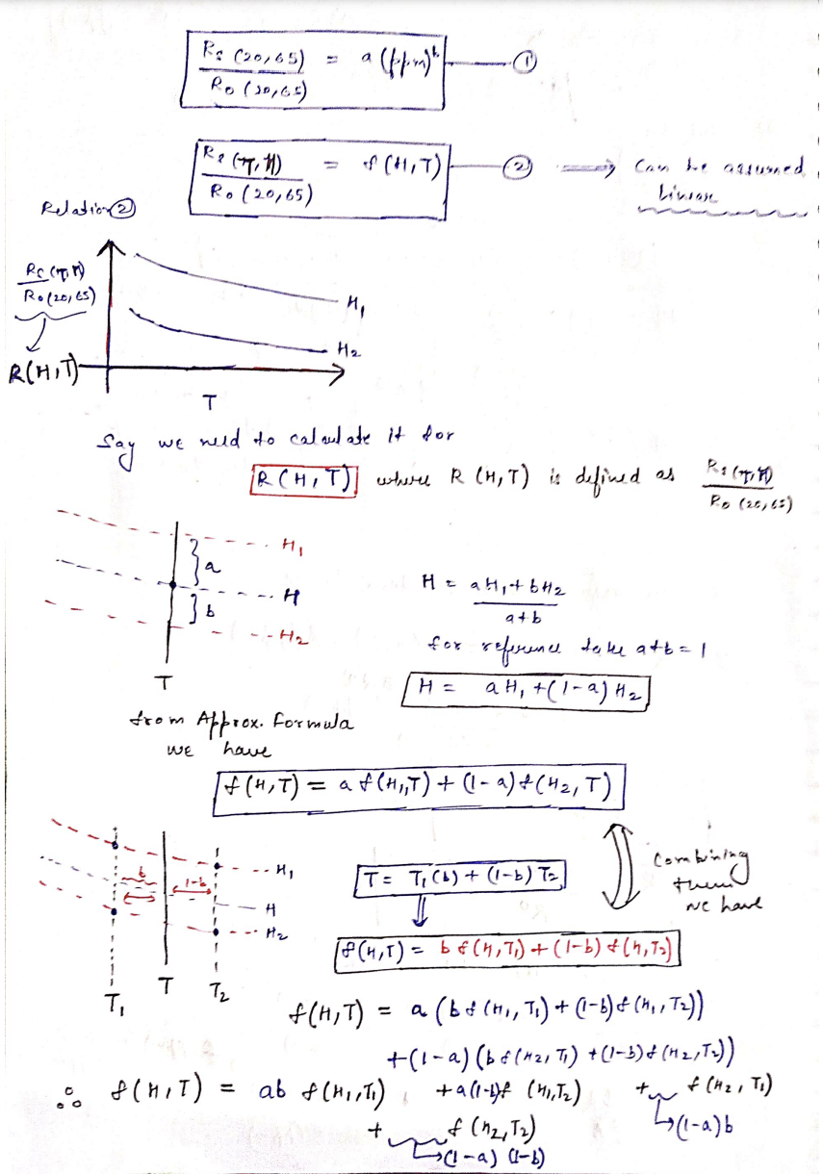
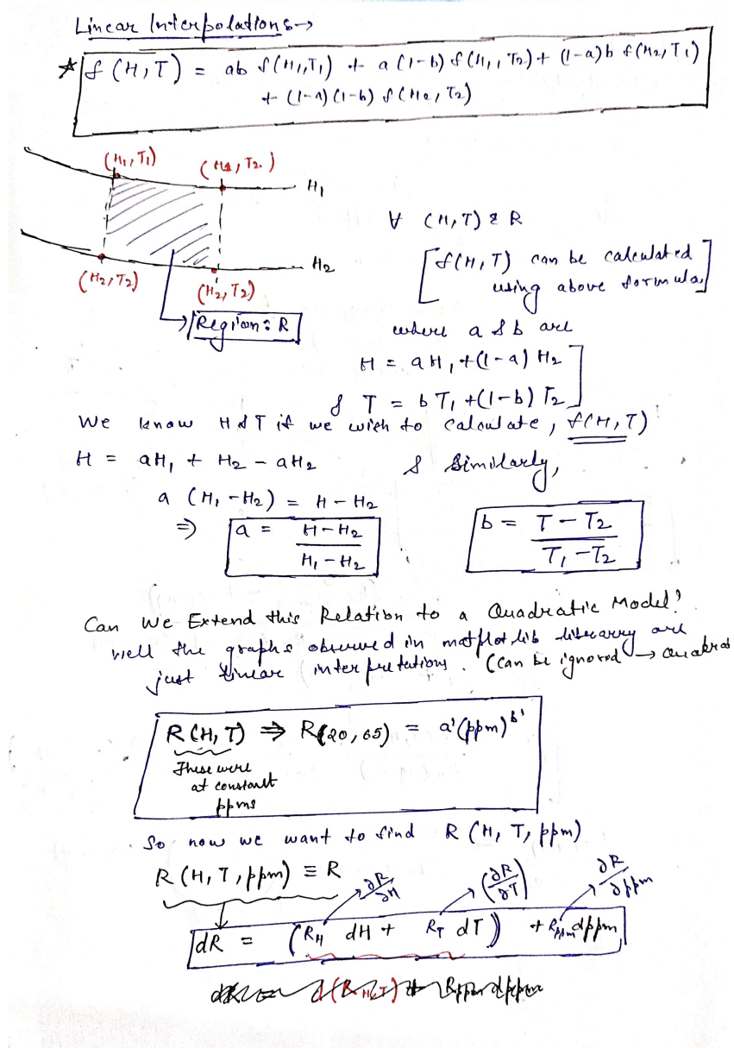


Slide 19
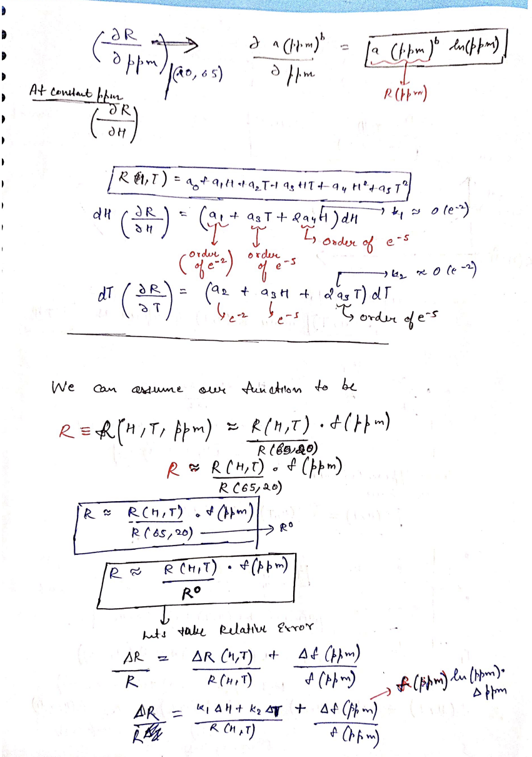
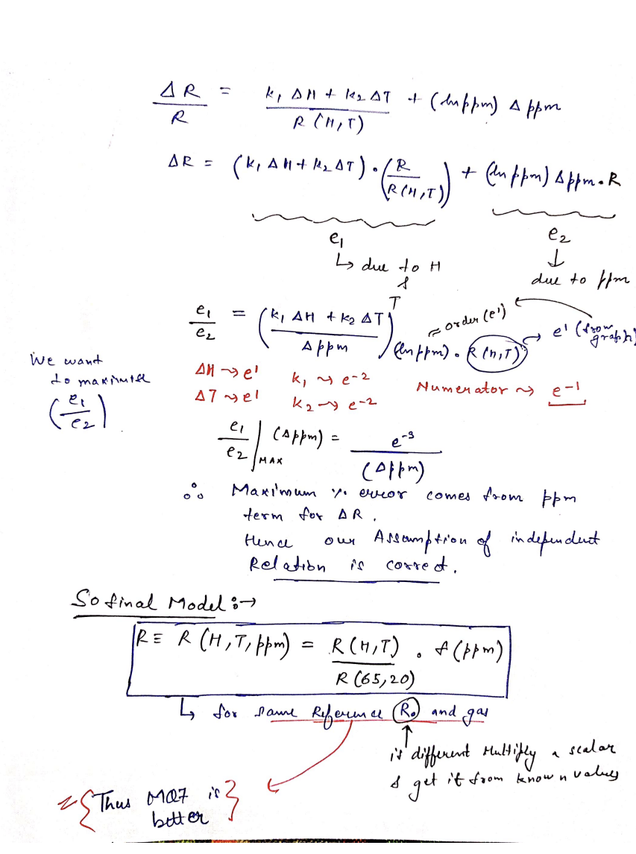
Derivation

Slide 20
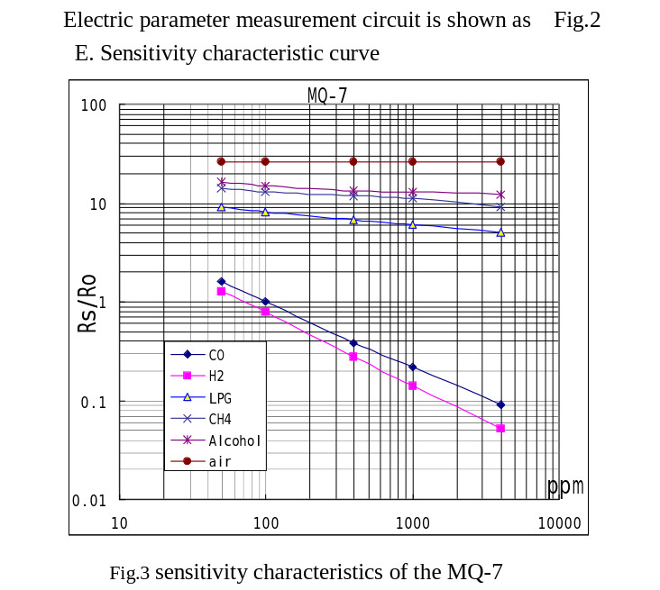
From the Datasheet of MQ7

Slide 21
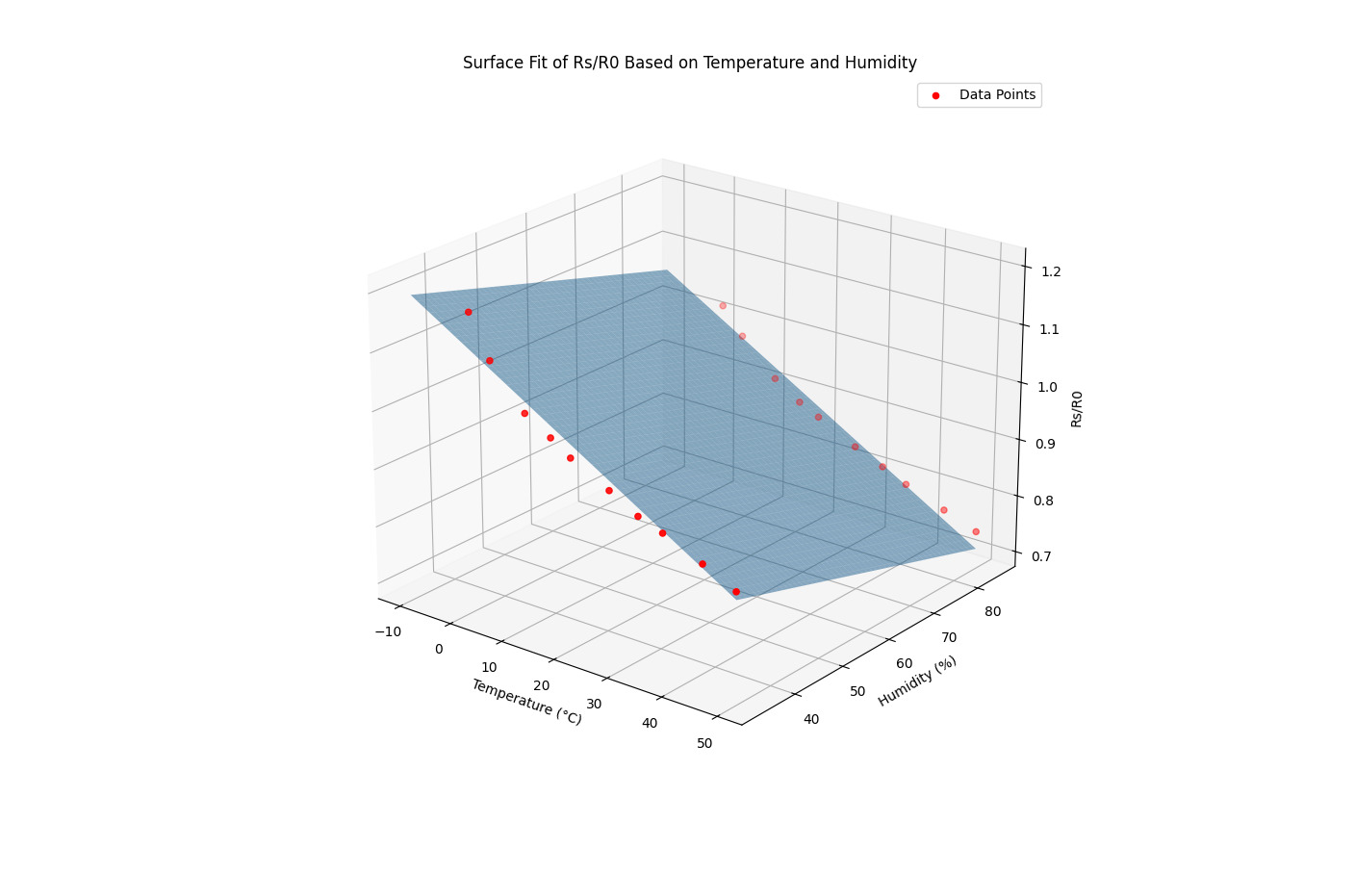
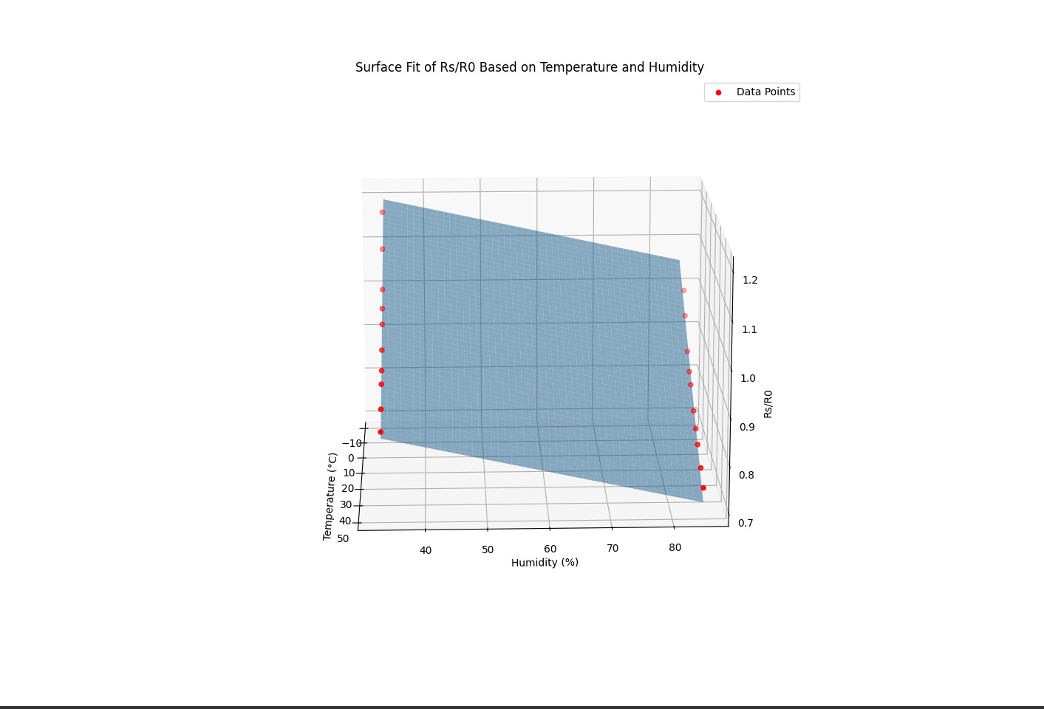
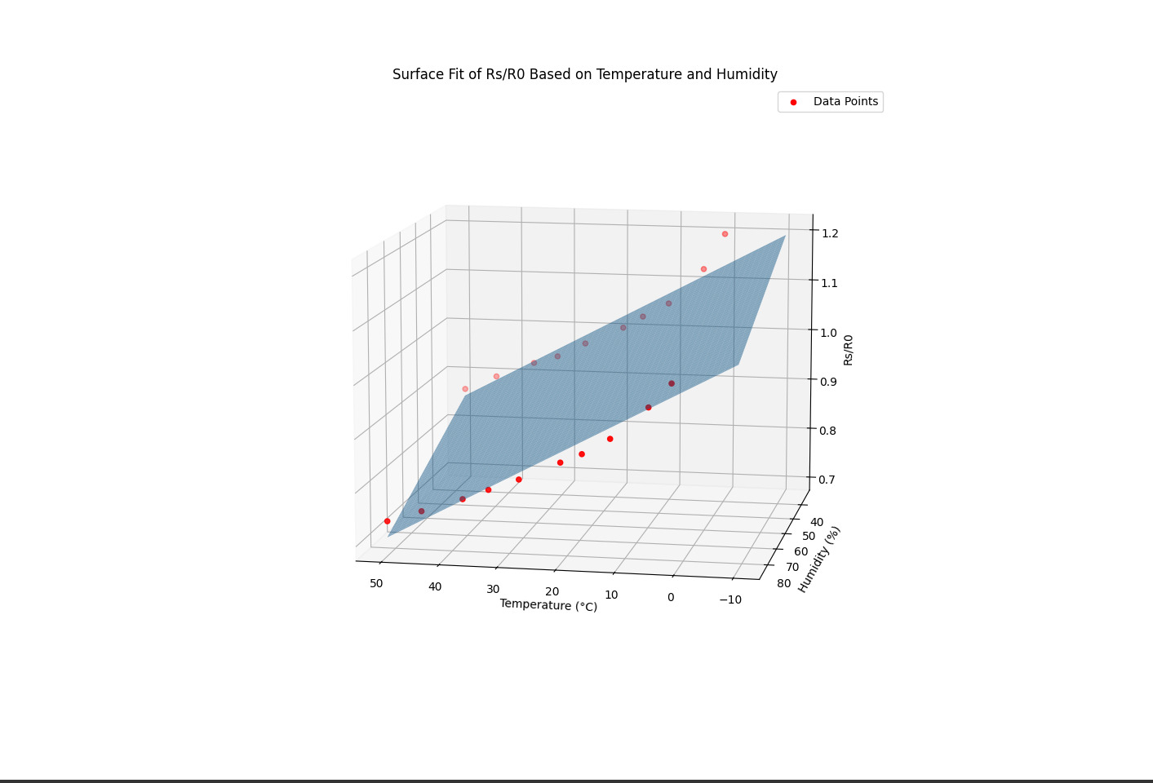
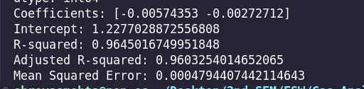
Linear Fit

Slide 22
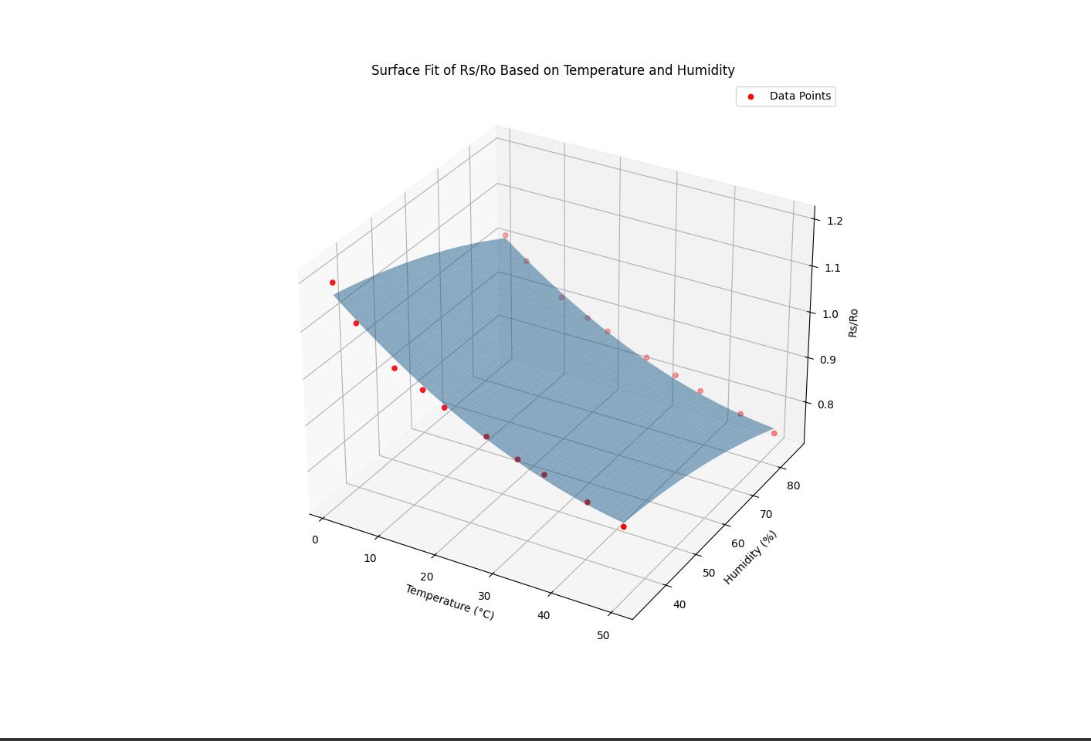
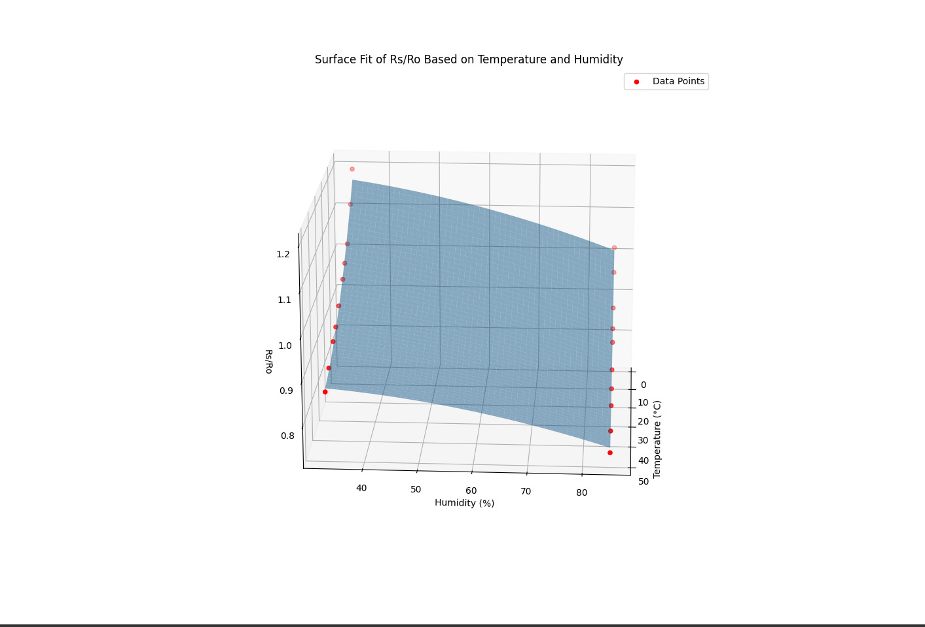
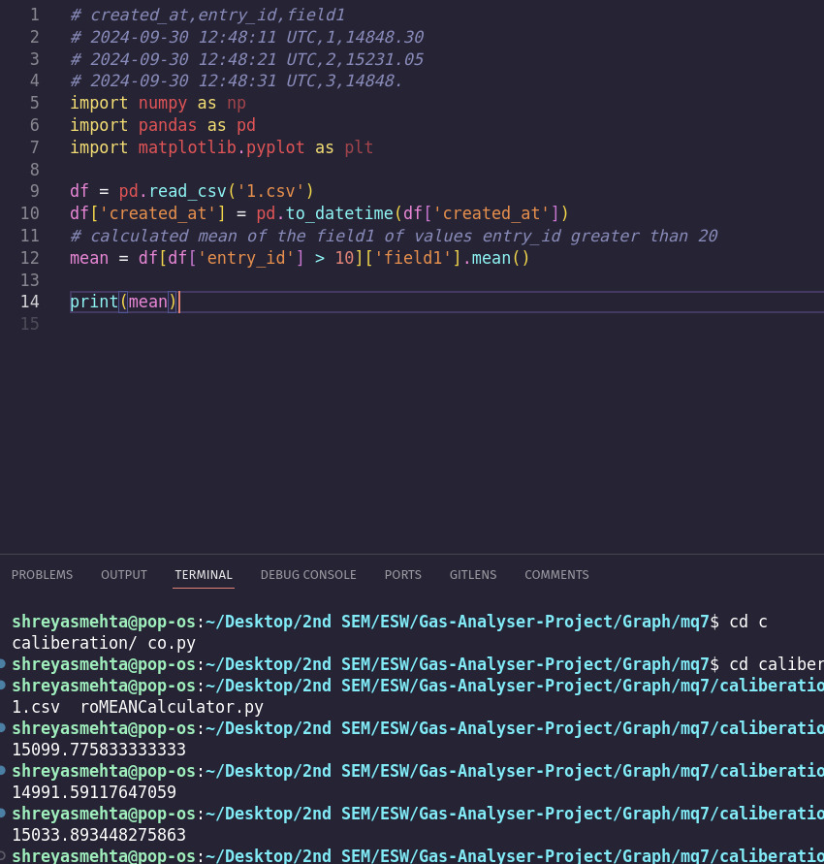
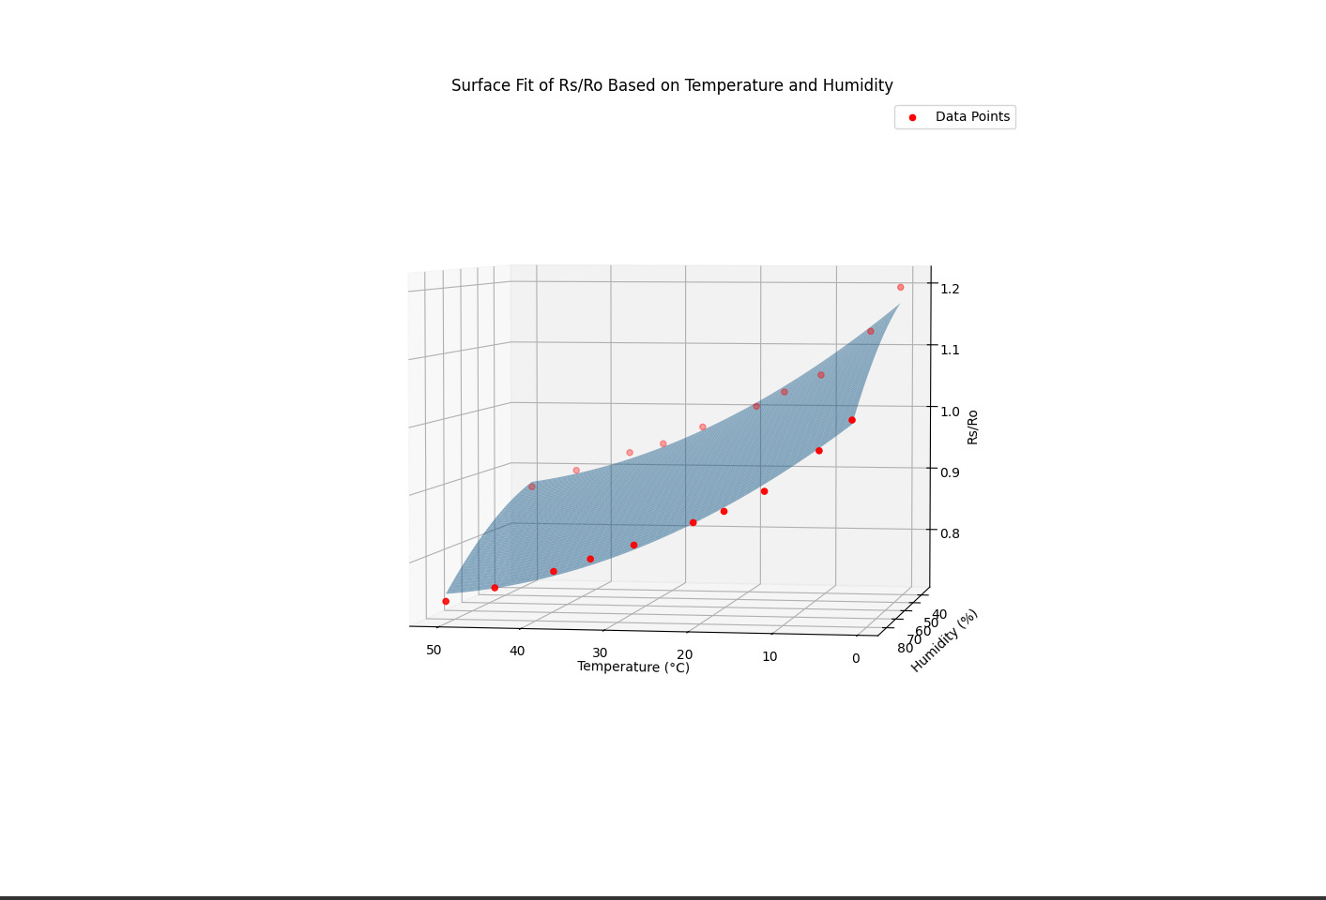

Quadratic Fit

Slide 23





Slide 24




Slide 25




Slide 26


Slide 27


Pure Air Testing

Slide 28


Slide 29
Targets for next week/ Any Suggestions ?
Objectives:
A sensor with good proximity sensitivity is needed (MQ sensors are prone to imprecise measurements) An almost final version of GUI of the platform will be made. Hardware work will be started, a rudimentary (test) version of the final device will be made (sensor dependent).

